Slide 1
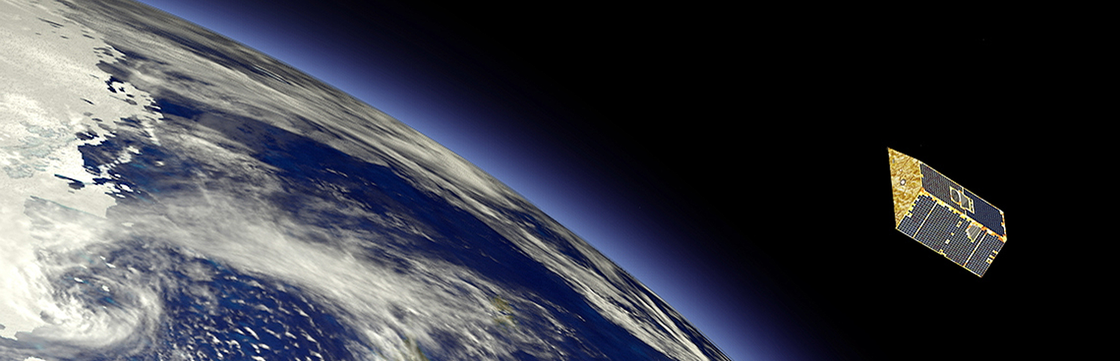




“She does space”
Investigating the near-Earth space environment, satellite drag, and more
Valerie Bernstein | Zonta D12 Amelia Earhart Meeting | January 23, 2021

Slide 2
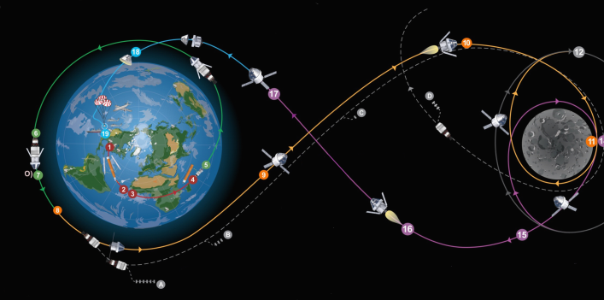
Mini Project for NASA Artemis 1
Image credit: NASA
We worked with a group of scientists who designed an experiment to study the effect of solar radiation on DNA of yeast cultures
Important as we prepare for sending humans to Mars
This experiment will orbit around the moon with Artemis 1

Slide 3
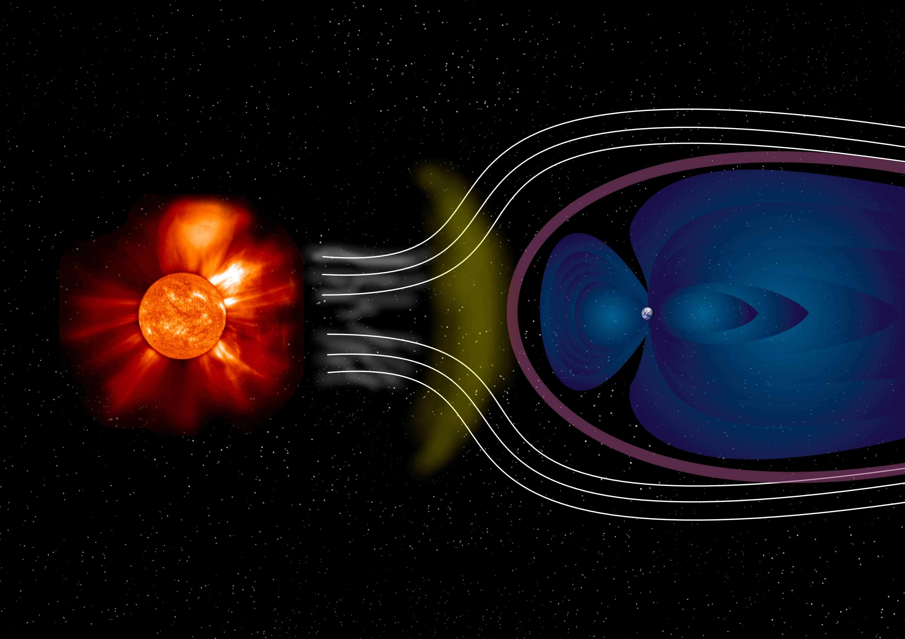
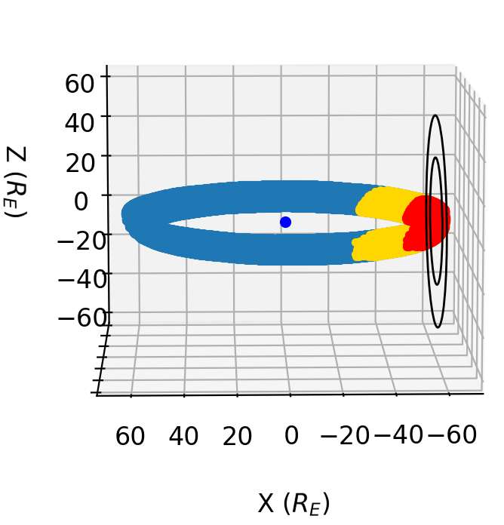
Mini Project for NASA Artemis 1
Magnetosphere = ‘force field’
Lunar Orbit
Earth
Moon
Solar Wind
Sun
Image credit: NASA, modified by D. Knipp and V. Bernstein

Slide 4

My PhD Research
Understanding how Earth’s atmosphere exerts forces on satellites and can change their orbits

Slide 5

Orbital Debris and Space Crowding

Slide 6
Pieces of the Puzzle
Surface Science
Astrodynamics
Aeronomy

Slide 7
Surface Science
Astrodynamics
Aeronomy
What’s going on in Earth’s upper atmosphere?

Slide 8
Surface Science
Astrodynamics
Aeronomy
What’s going on in Earth’s upper atmosphere?
How does stuff in the atmosphere interact with satellites?

Slide 9
Surface Science
Astrodynamics
Aeronomy
What’s going on in Earth’s upper atmosphere?
How does stuff in the atmosphere interact with satellites?
How does this affect satellite paths?

Slide 10
Surface Science
Astrodynamics
Aeronomy

Slide 11
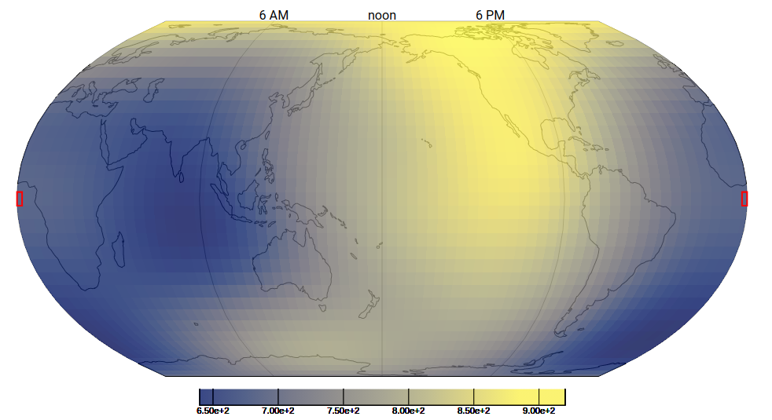



Aeronomy
Surface Science
Astrodynamics
Aeronomy
I use computer models of Earth’s global atmosphere to characterize atmospheric conditions
Composition
Density
Temperature
Temperature (K)
Image courtesy of Greg Lucas, CU Space Weather TREC

Slide 12
Surface Science
Surface Science
Astrodynamics
Aeronomy
I try to determine how atmospheric particles interact with satellite surfaces in orbit
I modify existing models and create new ones

Slide 13
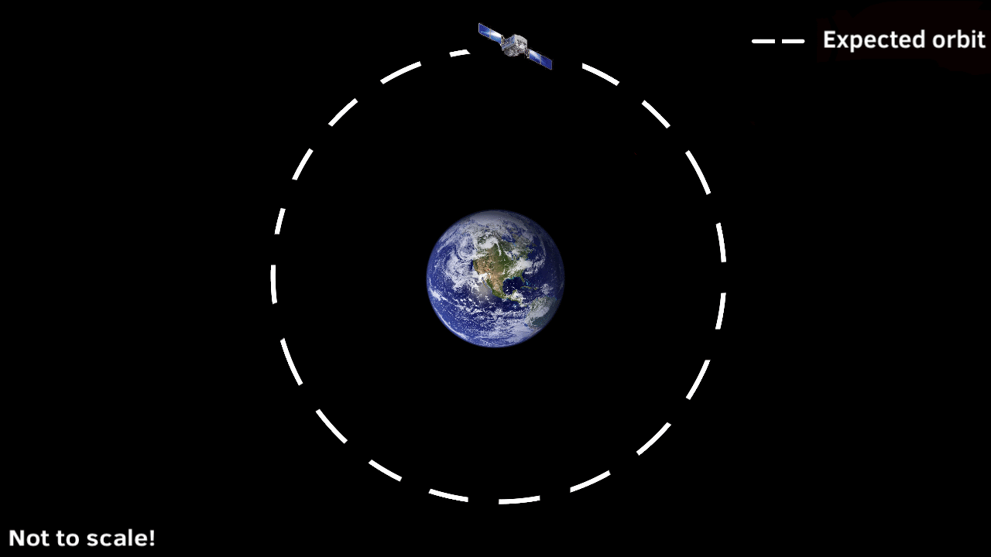
Why do we care how particles in the atmosphere interact with satellite surfaces?
Because this can change how much force the atmosphere is exerting on the satellite
This is what can perturb satellite paths
The satellite orbit gradually drops in height as it encounters more resistance force

Slide 14
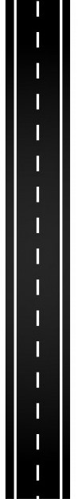


Why do we care how particles in the atmosphere interact with satellite surfaces?

Slide 15
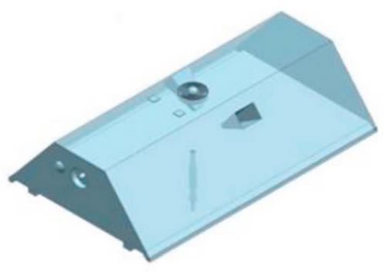

Astrodynamics
Surface Science
Astrodynamics
Aeronomy
I use satellite tracking data and computer models to get satellite orbits
Data provided by the North American Aerospace Defense Command

Slide 16
Surface Science
Astrodynamics
Aeronomy
My research methods and algorithms try to infer the right surface science from satellite observations

